Slide 1
IoT solutions on Azure
“ ”
autumn 2019 Joanna Lamch
Notes:
dziekuje ze tak licznie przybyliscie na moja prezentacje i mozliwosc podzielenia się z wami odrobina wiedzy jaka zebrałam …. Nie wiem co dodac
Chciałabym wam przybliżyć choć trochę temat web assembly –

Slide 2



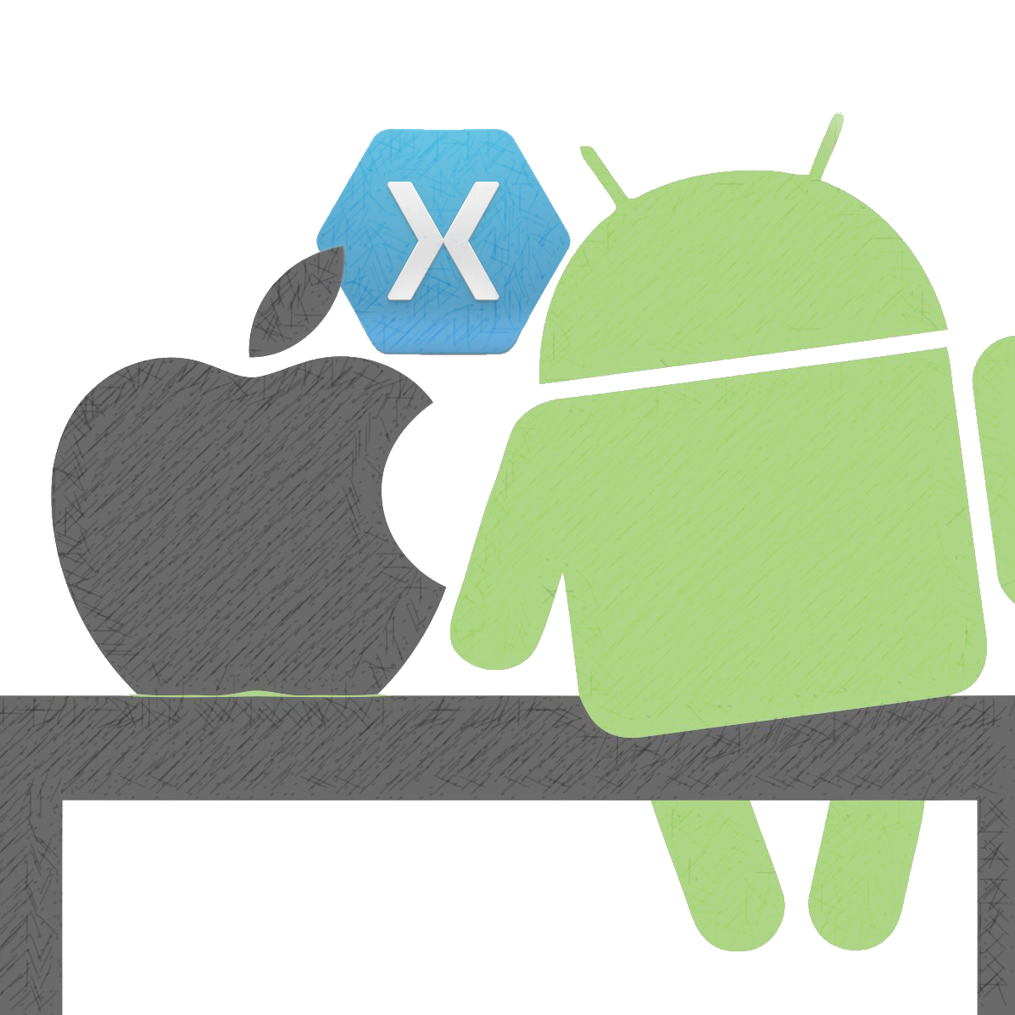

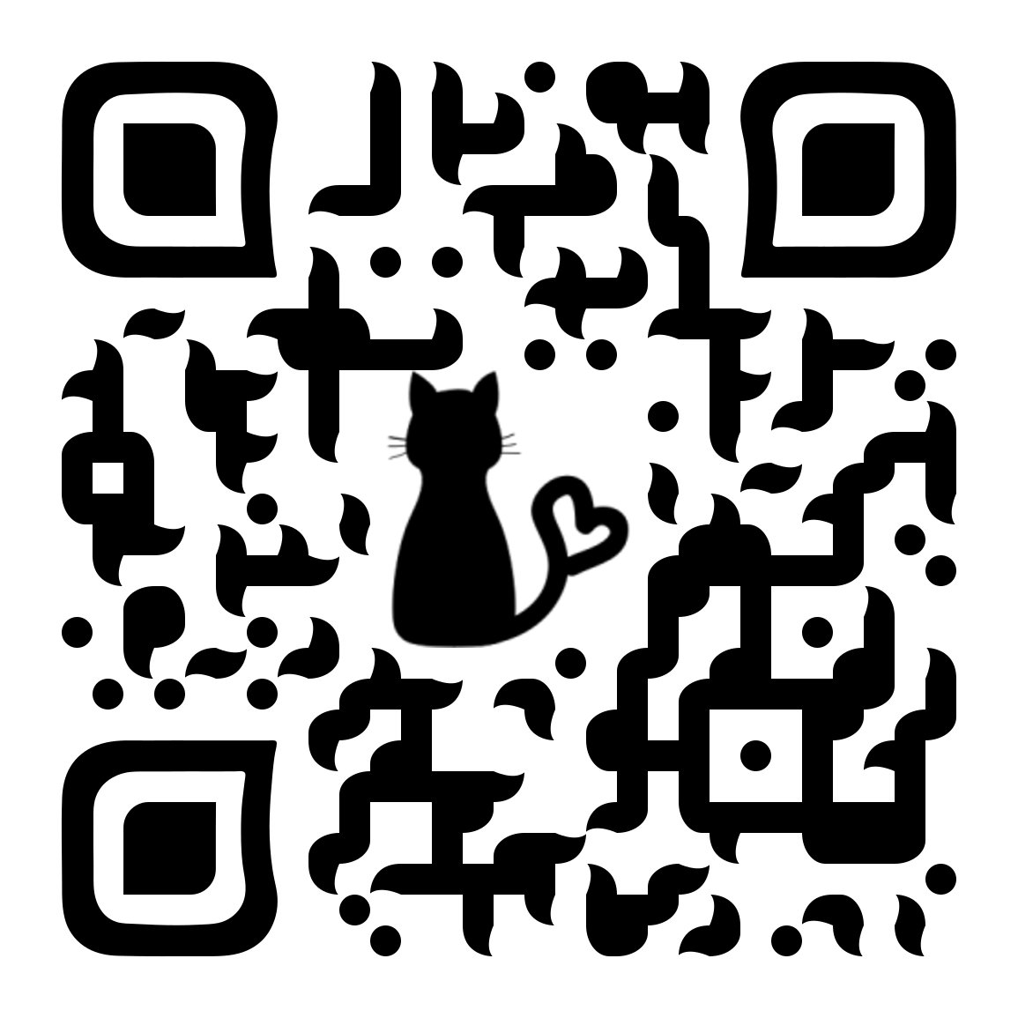

Who am I ?
Joanna Lamch
JLamch@gmail.com
JLamch.net
ProgramistkaIKot.pl
Microsoft fangirl
Developer C#
.NET Framework 1.1
15 years (+ overtime)
Xamarin
SIENN
Community
Śląska Grupa Microsoft Women In Technology Gruba.IT
Notes:
O mnie…
Zapraszam tez na troche inne spotkania WIT
Duzo case study, duzo wieddczy przeroznej

Slide 3
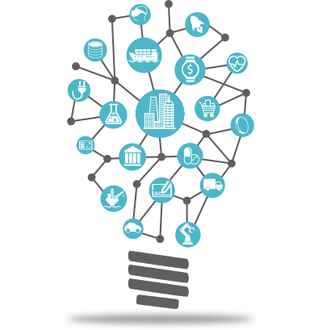
Internet of Things
The network of physical objects that contain embedded technology to communicate and interact with their internal states or the external environment.

Slide 4
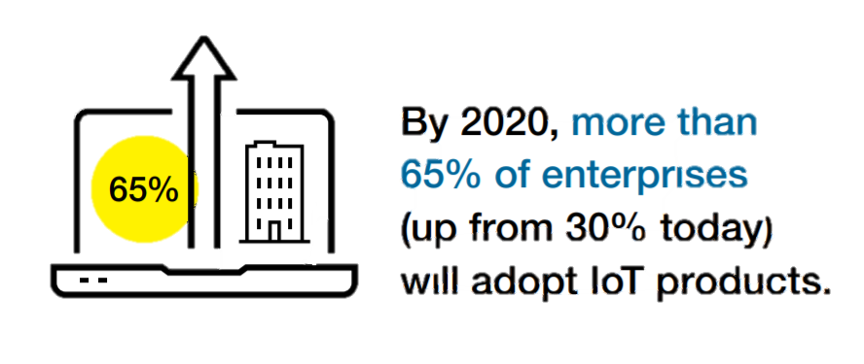
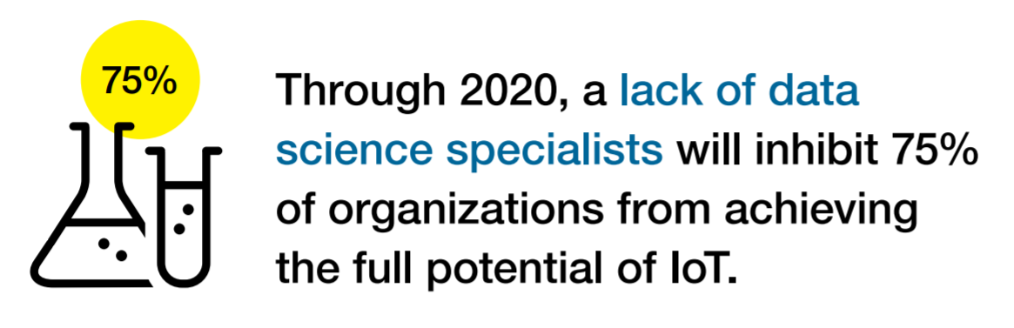
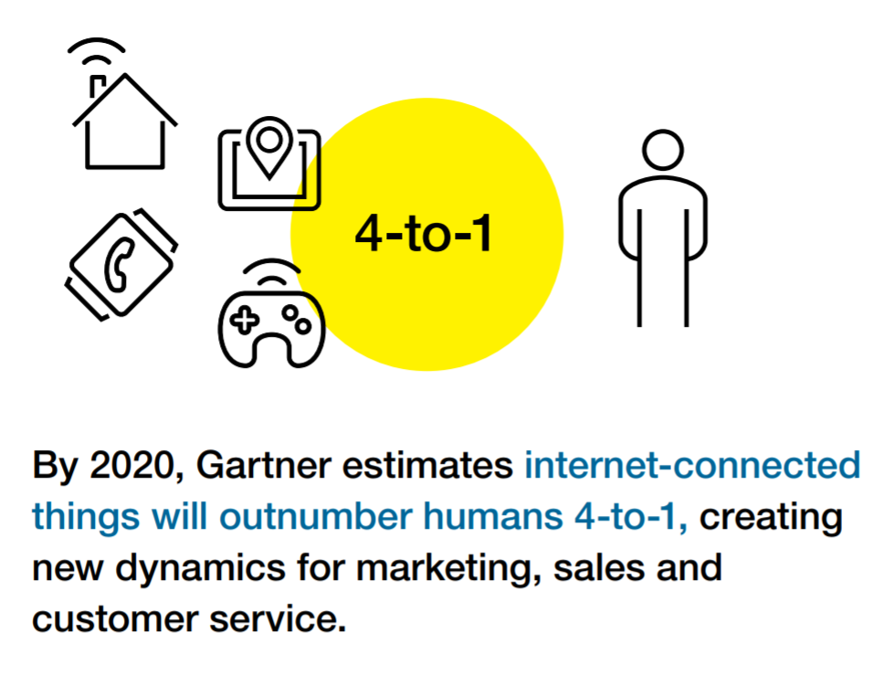
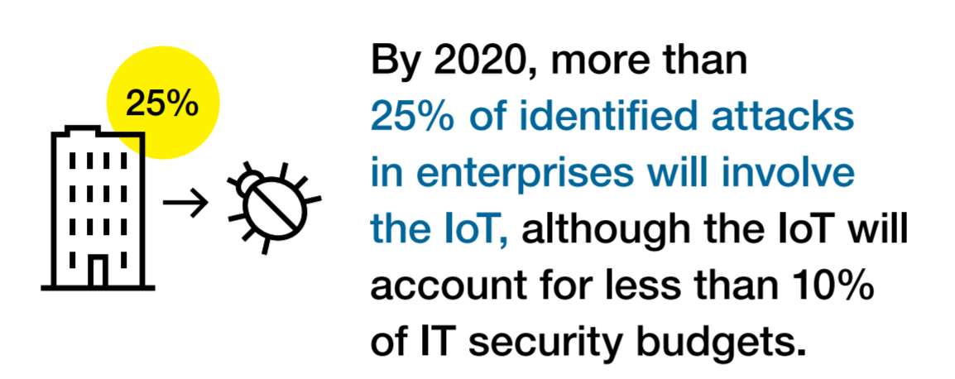
IoT by Gartner 2020
26 billions
Notes:
26 billion connected devices by 2020
Worldwide market for IoT solutions to reach $7.2 trillion in 2020 (IDC)
Economic value-add is forecast to be $2 trillion across sectors in 2020 177$ millions in productivity increase (Gartner)
Microsoft will invest $5B in IoT and intelligent edge till 2022
Leading Industry examples : utilities, insurance, agriculture, factory, automobiles, transport, consumer, etc

Slide 5
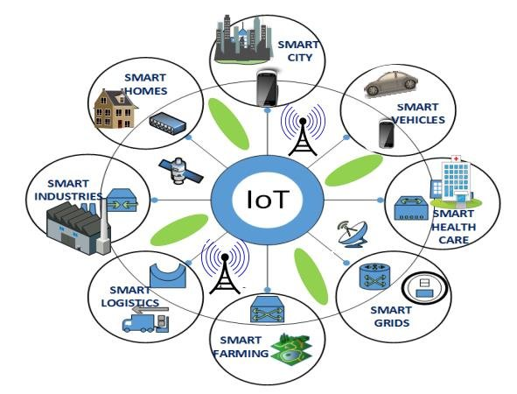
IoT business scenarios
Manufacturing
Smart City
Smart Building
Healthcare
Energy
Transportation and Smart Vehicles
Logistics and Inventory Management
Retail
Agriculture

Slide 6
IoT Business Maturity Model
1. Operational efficiency
Connect devices and monitor telemetry
Monitor and track device state, location and health
Things
Rules and alerting to improve operational efficiency
Notes:
Most customers adopting the IoT tend to follow a similar pattern.
- It starts with organizations hunting for operational efficiency.
- Subsequently they begin by connecting devices and capturing data. The cloud means that traditional concerns about ‘too much data’ are much less prevalent.
- Customers will be monitoring the IoT devices themselves and the things they they’re connected to.
Often customers will be using real time rules and alerting to make decisions in an ad hoc fashion about their things.

Slide 7
IoT Business Maturity Model
2. Business Intelligence
Analyze and visualize data from devices
Discover patterns in device data using predictive analytics
Things
Operationalize insights to improve things and processes in real time
Notes:
Next, organizations start to develop some business intelligence around the huge streams of data.
Once they’ve built a data set customers will start to derive insight from this. This moves from experimentation and exploration of data to insight, often using machine learning and other statistical and predictive models.
The cloud and predictive analytics work really well together. This is because predictive analytics requires a lot of computing power, which is ‘on tap’ in the cloud.
Insight allows customers to take better decisions as they run their business. Some of these will be real time operationalization of predictive models, some of these will be longer term strategic decisions.

Slide 8
IoT Business Maturity Model
3. Business Transformation
Combine IoT & other data with advanced analytics to power new services and revenue streams
Expand into new adjacent businesses
Things
New partnership opportunities
Notes:
Customers then integrate IoT into their broader business and explore new areas in which to deploy IoT solutions.
Data and devices in the field unlock new opportunities to partner with other organisations who’re also interested in the hardware platforms and data streams.
The cycle continues.

Slide 9
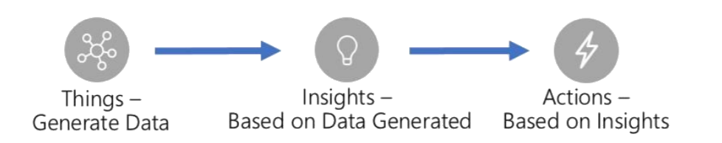
A simple view of an IoT solution
Things
Insights
Actions

Slide 10
A more realistic view…
Deployment
Fault tolerance
Solution scale
Data storage
Business process integration
Enterprise integration
Cold path analytics
Provisioning devices
Cost management
Operations monitoring
Device recovery
Internationalization
High availability
Updating devices
Cloud-to-device commands
Device lifecycle
Transport protocols
Warm path analytics
Drivers
Things
Disaster recovery
Insights
Actions
Hot path analytics
Device updates
Data ownership
< ---- END-TO-END SECURITY ---- >
On device analytics
Data visualization
Manufacturing scale
Industry and government compliance
HW certification
Securing data
… and why IoT needs simplifying
Device commercialization

Slide 11
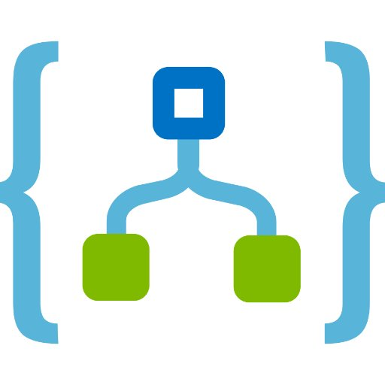




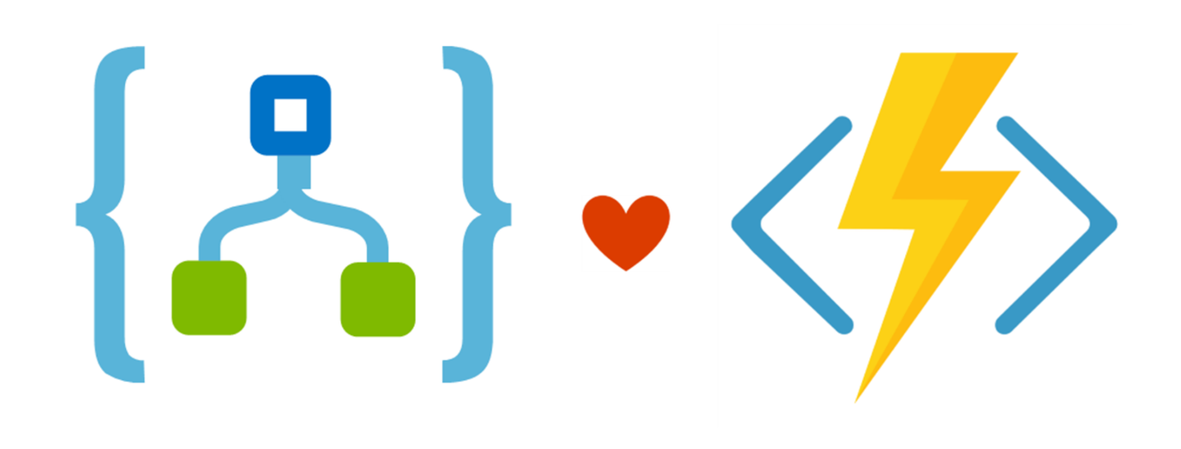








A more realistic view…
Fault tolerance
Solution scale
Data storage
Business process integration
Enterprise integration
Cold path analytics
Provisioning devices
Cost management
Operations monitoring
Device recovery
Internationalization
High availability
Deployment
Cloud-to-device commands
Updating devices
Transport protocols
Device lifecycle
Warm path analytics
Drivers
Things
Disaster recovery
Insights
Actions
Hot path analytics
Device updates
Data ownership
< ---- END-TO-END SECURITY ---- >
On device analytics
Data visualization
Manufacturing scale
Industry and government compliance
HW certification
Securing data
… and why IoT needs simplifying
Device commercialization

Slide 12
IoT architecture requirements
Handle extreme hardware and software heterogeneity
Build for hyper-scale and enable low data latency
Think about security, be secure by design; support defense in depth
Lower barriers to entry: evaluate -> prototype -> deploy -> update Think big, but start small (experiment, learn and refine)
Deliver telemetry and notifications that are meaningful even at extreme scale
Provide hot-path and cold-path analysis and action/response.

Slide 13
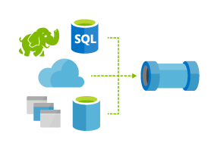
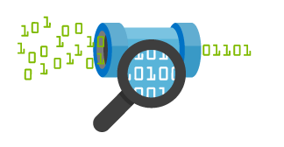
Things
Insights
Actions
Azure IoT Architecture
Cold Path Analytics
Find insights over historical data
Technology
Azure ML, and Azure Data Lake Analytics
Things
Insights
Actions
Technology
Azure IoT Device SDK
Azure IoT Edge
IoT Hub Cloud Gateway
Connect and Manage Devices
Hot Path Analytics
Real-time monitoring
Technology
Azure Stream Analytics, and HDInsight Spark & Storm
Manage
View and manage solutions
Technology
App Service, Power Bi, API Apps, Mobile Apps, Xamarin Apps, and Azure Search
Protocol Adaptation
Warm Path Analytics
Ad-hoc visual exploration of time series data
Technology
Azure Time Series Insights
Field Gateway
Protocol Adaptation
Business Integration
Connect to business process
Technology
Azure Logic Apps, API Management, Biztalk Services
Field Gateway

Slide 14
Lambda Architecture
slow path
Things
Insights
Actions
IoT Hub Cloud Gateway
Store
Display
Analyze
Action
fast path
Analyze
Action
Route
Store
Display

Slide 15
Azure IoT Hub
Device handling special force unit

Slide 16
Azure IoT Hub
Bi-directional communication

Slide 17

IoT Communication - Information Exchange Patterns
Information flowing from a device to other systems for conveying status of device and environment
Telemetry
Requests from devices looking to gather required information or to initiate activities
Inquiries
Commands from other systems to a device or a group of devices to perform specific activities
Commands
Information flowing from other systems to a device (group) for conveying status changes
Notifications

Slide 18
Azure IoT Hub
Bi-directional communication
Millions of Devices
Multi-language, open source SDKs
HTTPS/AMQPS/MQTTS
Multi-language, open source SDKs
HTTPS vs AMQPS vs MQTTS

Slide 19
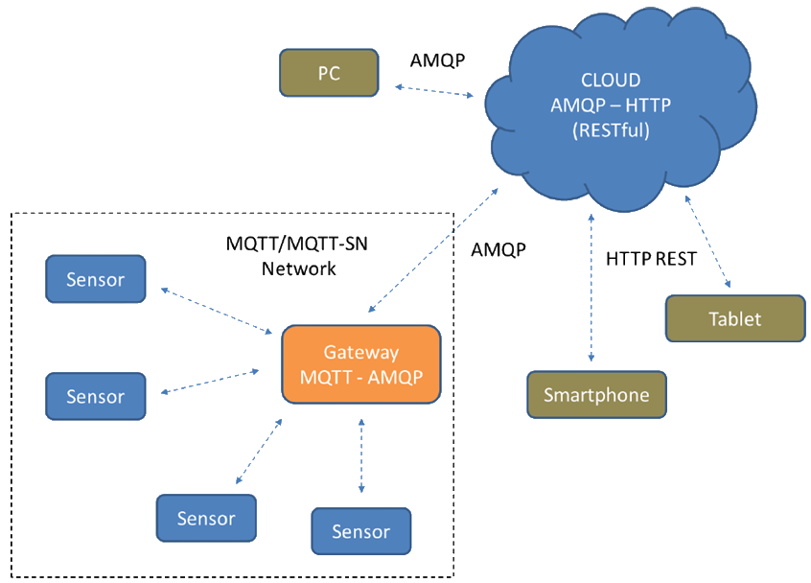
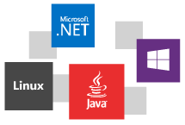
Azure IoT Hub
Multi-language, open source SDKs
HTTPS vs AMQPS vs MQTTS

Slide 20
Azure IoT Hub
Bi-directional communication
Millions of Devices
Multi-language, open source SDKs
HTTPS/AMQPS/MQTTS
Send Telemetry
Receive Commands
Device Management
Device Twins
Queries & Jobs
Multi-language, open source SDKs
HTTPS vs AMQPS vs MQTTS
Device Management
Device Twin

Slide 21
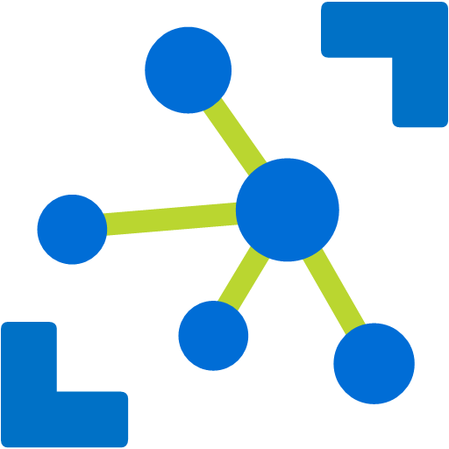

Device Twin
Azure IoT Hub Device Twin Device Management
Device Management
Software Firmware Configuration
IoT Hub
IoT Device
Telemetry
Telemetry channel
Device Twin
Device Twin
Properties
Properties
Cloud owned, device visible
Desired
Desired
Reported
Reported
Device owned, cloud visible
Tags
Cloud only,
device metadata
Methods
Methods
Cloud initiated C2D with response
Commands
Cloud initiated C2D message
Notes:
Easier to manage devices at scale

Slide 22

Device Twin vs Digital Twin
Twin is a cloud base representation of something that is remote
Device Twin is
A key/value flat representation of
Desired configuration
Reported configuration
Keys to match to an external database
Digital Twin is
A graph
Richer semantics
Not only devices – focused on resources

Slide 23
Azure IoT Hub
Bi-directional communication
Enterprise scale & integration
Millions of Devices
Multi-language, open source SDKs
HTTPS/AMQPS/MQTTS
Send Telemetry
Receive Commands
Device Management
Device Twins
Queries & Jobs
Billions of messages
Scale up and down
Declarative Message Routes
File Upload
WebSockets & Multiplexing
Azure Monitor
Azure Resource Health
Configuration Management

Slide 24
Azure IoT Hub
Bi-directional communication
Enterprise scale & integration
End-to-End Security
Millions of Devices
Multi-language, open source SDKs
HTTPS/AMQPS/MQTTS
Send Telemetry
Receive Commands
Device Management
Device Twins
Queries & Jobs
Billions of messages
Scale up and down
Declarative Message Routes
File Upload
WebSockets & Multiplexing
Azure Monitor
Azure Resource Health
Configuration Management
Per Device Certificates
Per Device Enable/Disable
TLS Security
X.509 Support
IP Whitelisting/Blacklisting
Shared Access Polices
Firmware/Software Updates

Slide 25
IoT protection stack
Device protection
Threat resistance
Data protection in-motion
Cloud security
Response
Trusted Platform Module (TPM)
Device Guard
X.509 or TLS-Based Handshake and Encryption
Encryption at Rest
Azure Active Directory
Key Vault
Policy-Based Access Control
IP- based blocking
Secure Device Registration
Standards-based best practices
Device Management
Device Recovery
Device-specific repudiation

Slide 26
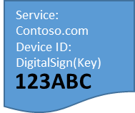


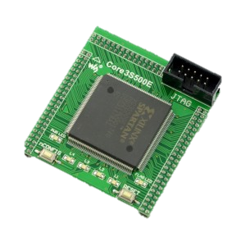


Provision devices at scale: DPS
IoT Hub Device Provisioning Service
Enables IoT devices to receive provisioning
information automatically
without manual interaction
when the device
first connects
to a network.
Azure IoT Hub Device Provisioning service
Azure IoT Hub
Service: Contoso.com
HW ID:
Device ID:
DigitalSign(Key)
3
123ABC
HW with ID “123ABC”
was produced
URL, Device Name, SymKey
4
I am “DigitalSign(Key)”:
[Data] & [DM]
I am device “123ABC”
1
2
123ABC
123ABC
Manufacturer
Shipping
Customer

Slide 27
Microsoft is simplifying IoT
Azure IoT Solution Accelerators Solution accelerators for common IoT scenarios
Azure IoT Central Fully managed IoT SaaS
No cloud solution expertise required
Remote Monitoring | Predictive Maintenance | Connected Factory
SaaS
Azure IoT Hub
Azure Stream Analytics
Azure Time Series Insights
Azure Machine Learning
Azure Logic Apps
More
PaaS

Slide 28
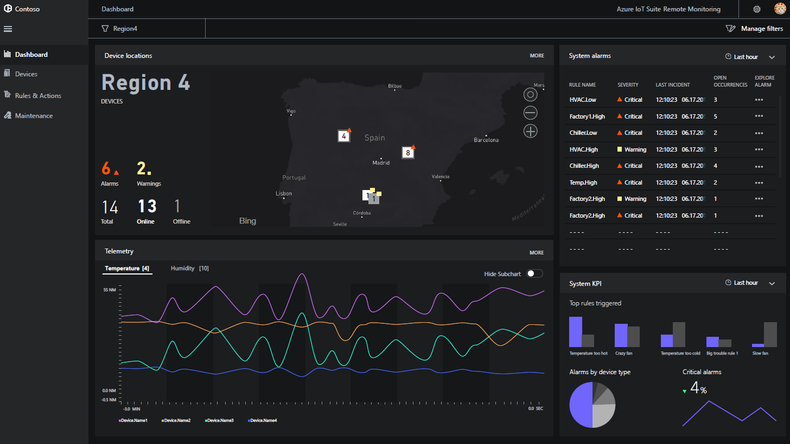
Azure IoT solution accelerators
Device Connectivity & Management
Data Ingestion and Command & Control
Stream Processing & Predictive Analytics
Workflow Automation and Integration
Dashboards, Visualization & Insights
Preconfigured Solutions
Remote monitoring
Predictive maintenance
Connected factory

Slide 29
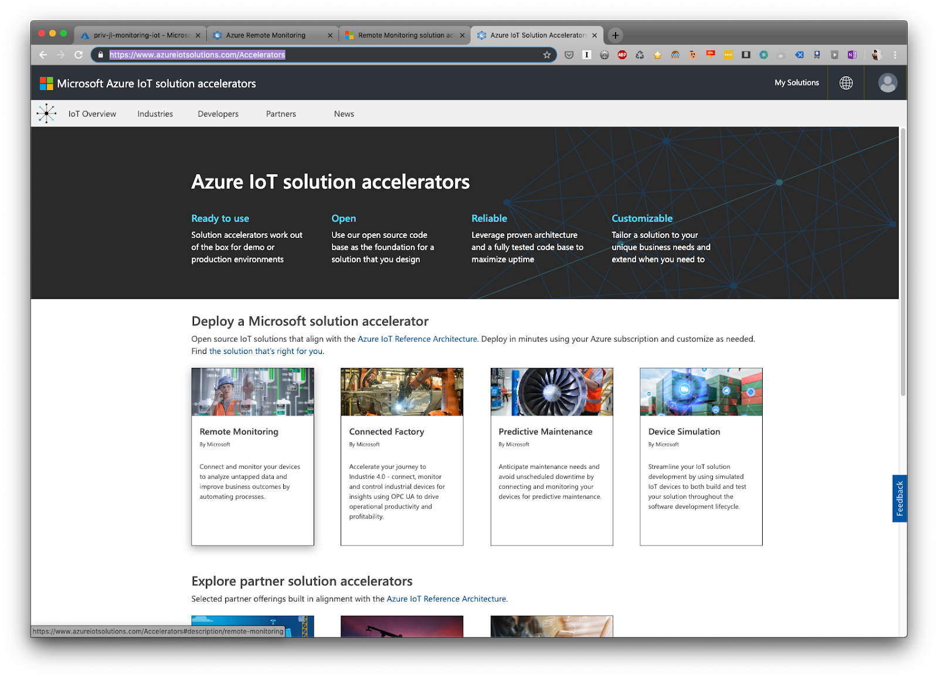
Azure IoT solution accelerators

Slide 31
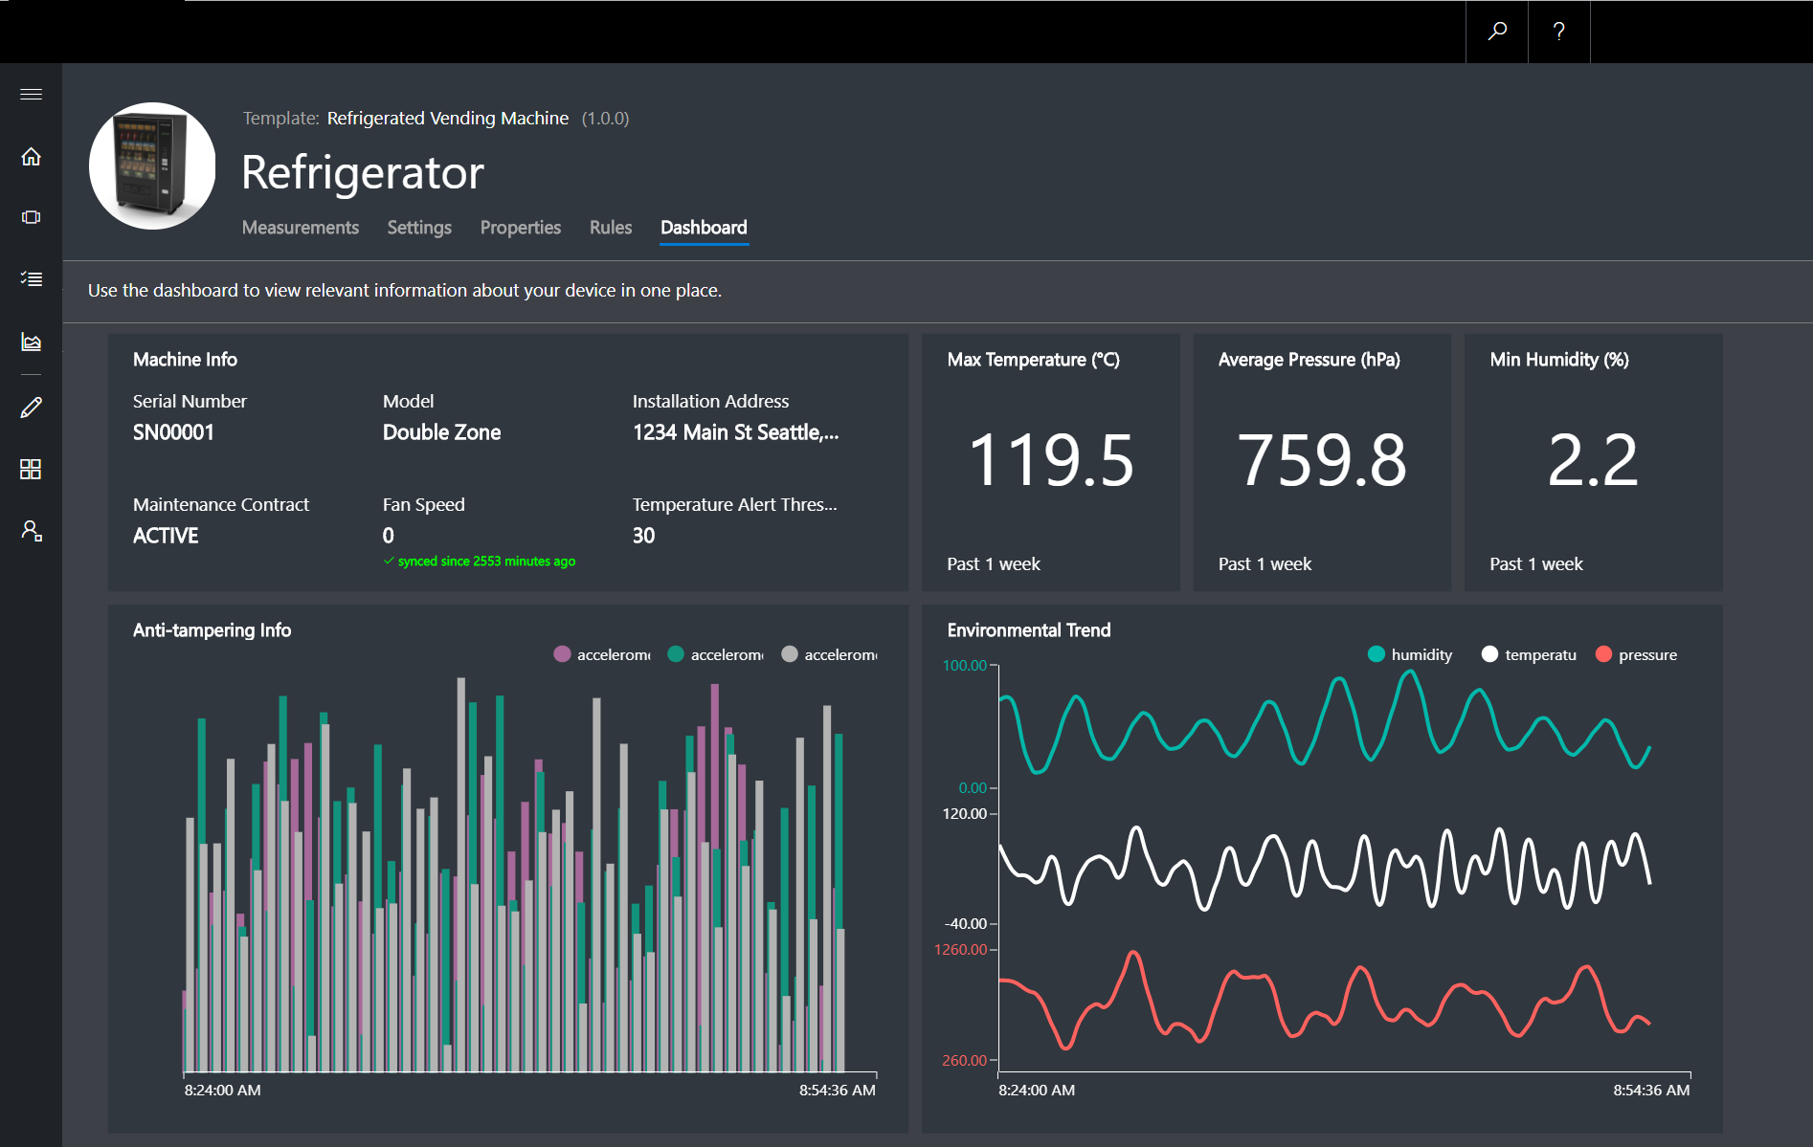
Azure IoT Central
Device Connectivity & Management
Telemetry Ingestion and Command & Control
Monitoring Rules & Triggered Actions
User roles and permissions
Dashboards, Visualization & Insights
Fully Hosted & Managed by Microsoft

Slide 32

Iot central Demo

Slide 33

Questions??
Joanna Lamch
JLamch@gmail.com
JLamch.net
ProgramistkaIKot.pl
THANK YOU

Slide 34
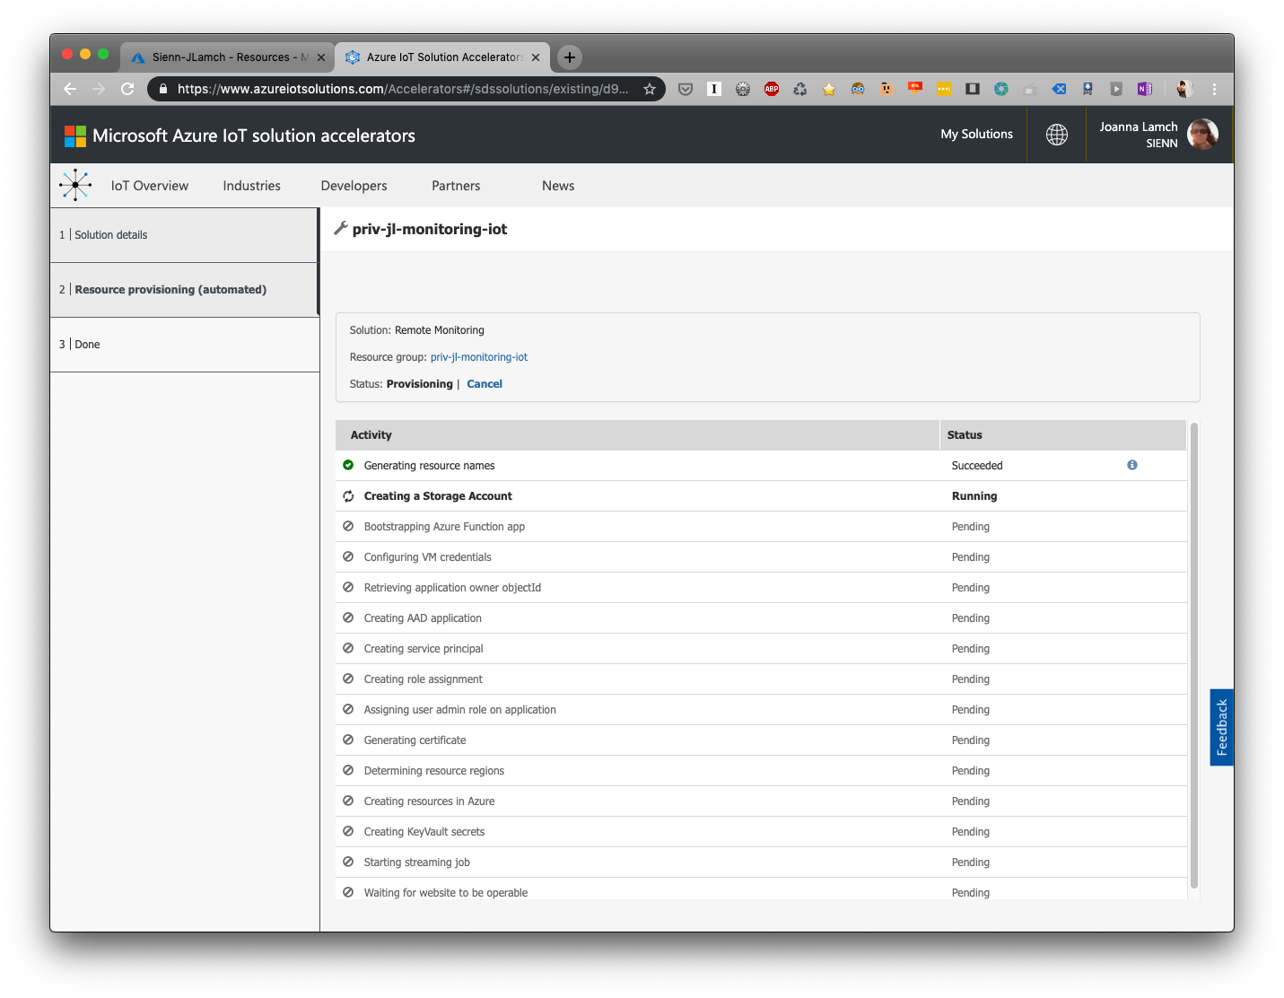

Slide 35
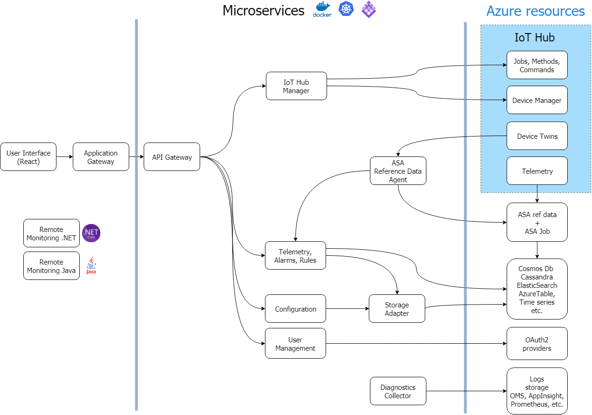
Remote monitoring
https://github.com/Azure/azure-iot-pcs-remote-monitoring-dotnet/

Slide 36
Remote monitoring
https://github.com/Azure/azure-iot-pcs-remote-monitoring-dotnet/

Slide 37
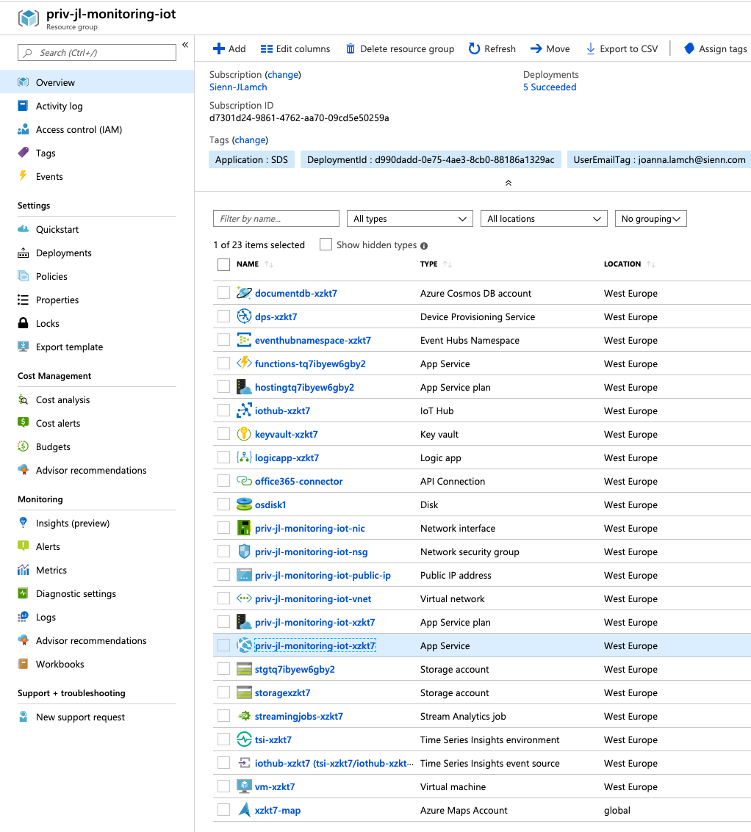

Slide 40
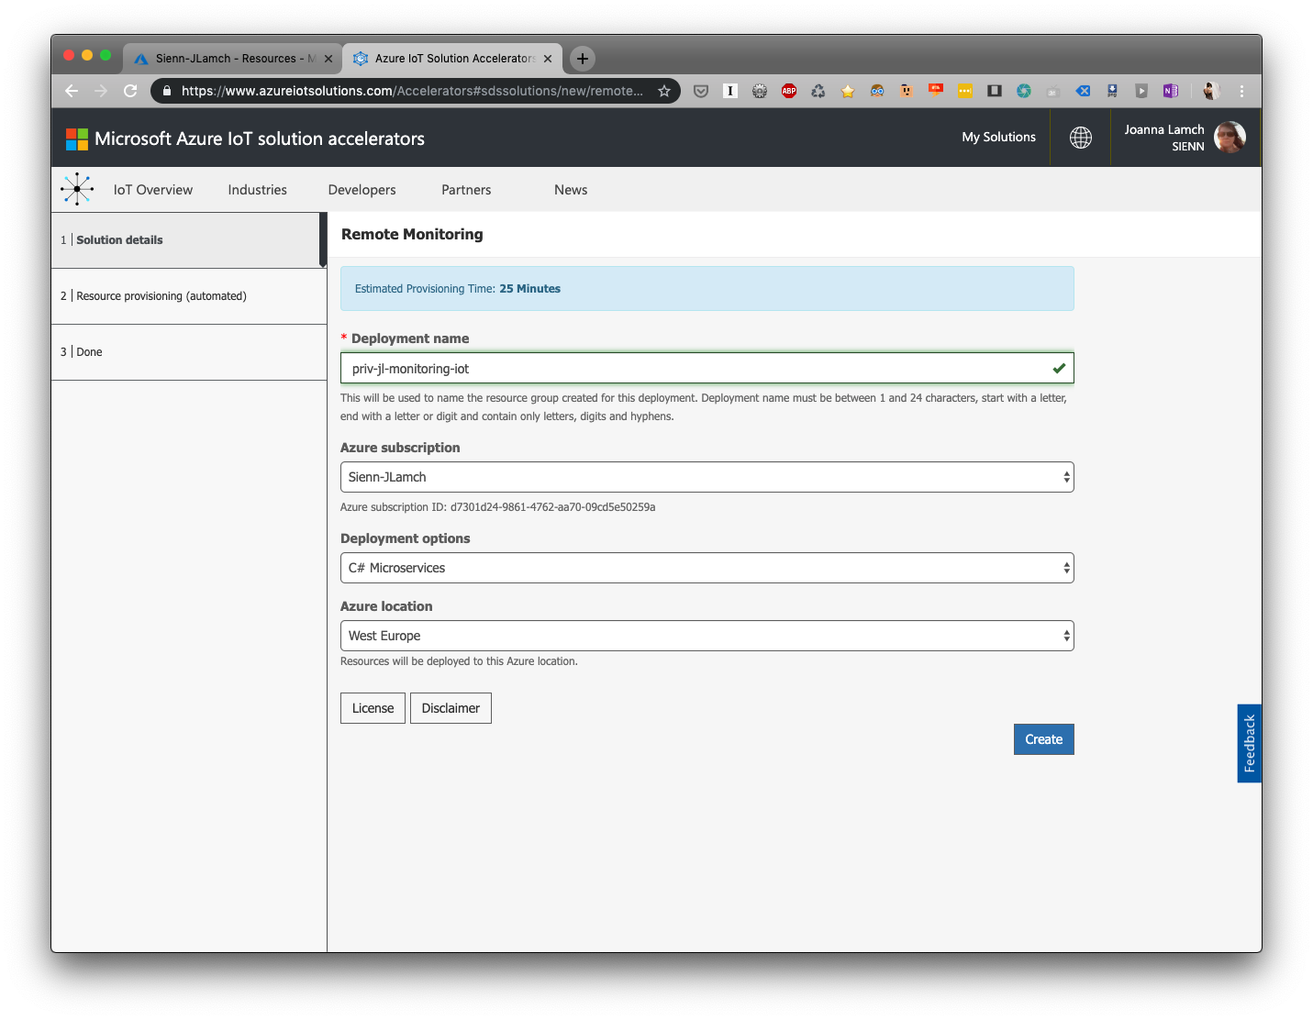

Slide 41
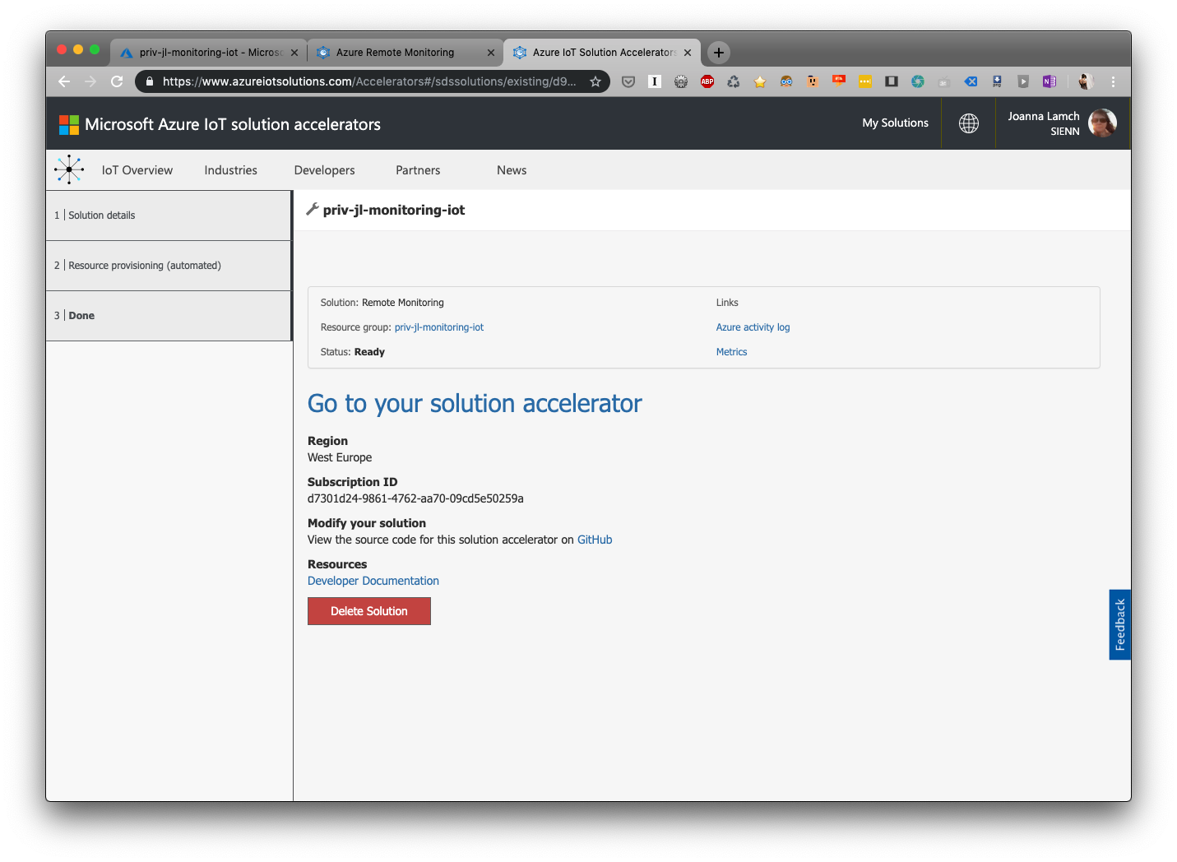

Slide 42
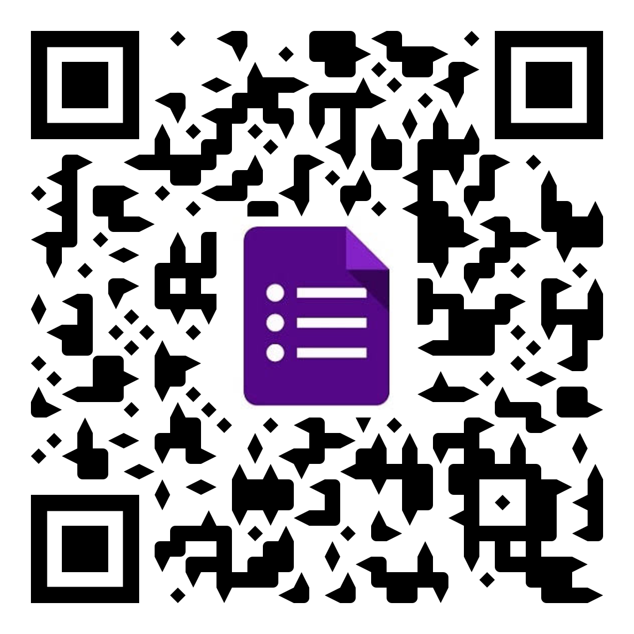
Ankieta
Działanie pociąga za sobą koszty i ryzyko, ale o wiele mniejsze niż te, które wiążą się z wygodną bezczynnością
Będzie mi miło móc ulepszyć moją prezentację dzięki Twoim komentarzom, dlatego proszę Cię o wypełnienie ankiety, bądź kontakt mailowy.

Slide 43
Bibliografia
https://iotschool.microsoft.com/en-us/home

Slide 44
Architecture summary
Think big (architecture), but start small (experiment, learn and refine).
Start with telemetry. Address privacy, security and manageability before moving to command and control.
Don’t interrupt the fast path and create processing bottlenecks.
Think about security, identity and management from the very beginning, and through the life of the product.
Build to the reference architecture to ease the move to IoT Suite.

Slide 45
Expectations
Plan
Level 200
There will be no coding
There will be hardware
There will be ”flashing light” demo, but it will be Azure based
There will be a lot of Azure
What is IoT
Reference Architecture
Azure IoT Hub
Azure Device Provisioning Service
Demo: IoT Hub
MxChip
Demo: MxChip getting started
Remote monitoring
Demo: Remote monitoring

Slide 46
Oczekiwania:
Poziom 200
Nie będziemy kodować
Będzie dużo Azura
Będzie hardware
Będzie „Hellow world” demo, ale w oparciu o Azura
Plan Będzie trochę wprowadzenia w koncepty IoT i trochę przykładów, tak aby zobaczyć jak dane wędrują do internetu z urządzeń.
Co to jest IoT
Architektura referencyjna
Azure IoT Hub
Azure Device Provisioning Service
Praca własna: IoT Hub
MxChip
Praca własna: MxChip – pierwszy kontakt
Azure IoT solution accelerators: Remote Monitoring
Praca własna: Remote monitoring
Expectations:
Level 200
There will be no coding
There will be hardware
There will be ”flashing light” demo, but it will be Azure based
There will be a lot of Azure
Plan:
What is IoT
Reference Architecture
Azure IoT Hub
Azure Device Provisioning Service
Demo: IoT Hub
MxChip
Demo: MxChip getting started
Remote monitoring
Demo: Remote monitoring

Slide 47
Requirements
VS Code, Azure subscription
Azure IoT Tools VS Code plugin
https://marketplace.visualstudio.com/items?itemName=vsciot-vscode.azure-iot-tools
Azure IoT Workbench VS Code plugin
https://marketplace.visualstudio.com/items?itemName=vsciot-vscode.vscode-iot-workbench
ST Link driver for Windows
https://www.st.com/en/development-tools/stsw-link009.html
IoT Hub Toolkit VS Code plugin
https://marketplace.visualstudio.com/items?itemName=vsciot-vscode.azure-iot-toolkit
Arduino IDE
https://www.arduino.cc/en/Main/Software
Arduino VS Code plugin
https://marketplace.visualstudio.com/items?itemName=vsciot-vscode.vscode-arduino

Slide 48
VS Code plugin configuration
Add following lines to configure Arduino depending on your platform:
Windows: JSONCopy "arduino.path": "C:\\Program Files (x86)\\Arduino", "arduino.additionalUrls": "https://raw.githubusercontent.com/VSChina/azureiotdevkit_tools/master/package_azureboard_index.json"
macOS: JSONCopy "arduino.path": "/Applications", "arduino.additionalUrls": "https://raw.githubusercontent.com/VSChina/azureiotdevkit_tools/master/package_azureboard_index.json"
Ubuntu: Replace the {username} placeholder below with your username. JSONCopy "arduino.path": "/home/{username}/Downloads/arduino-1.8.8", "arduino.additionalUrls": "https://raw.githubusercontent.com/VSChina/azureiotdevkit_tools/master/package_azureboard_index.json"

Slide 49
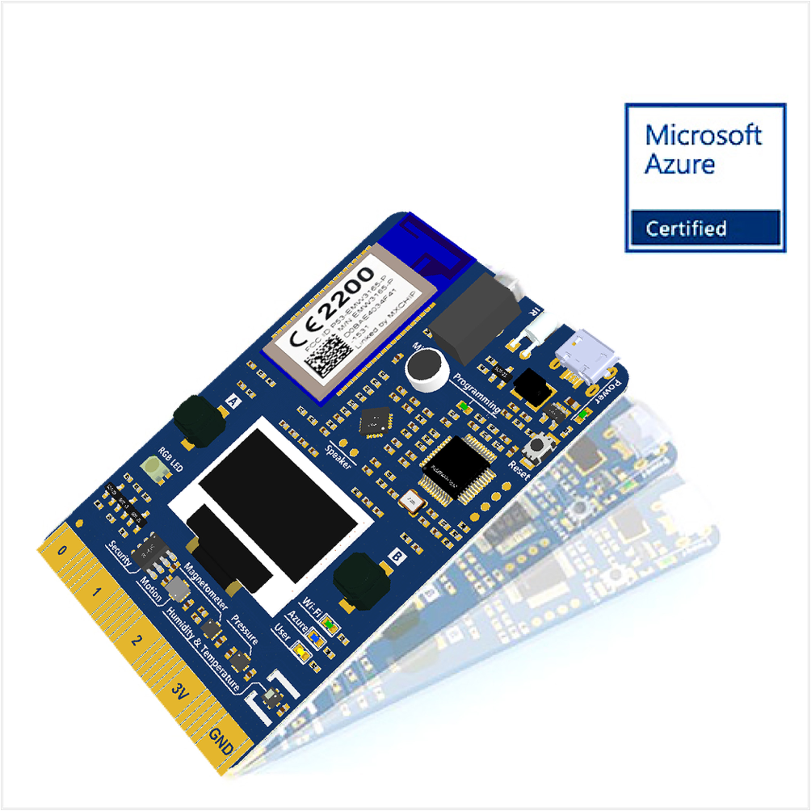
MXChip az3166

Slide 50
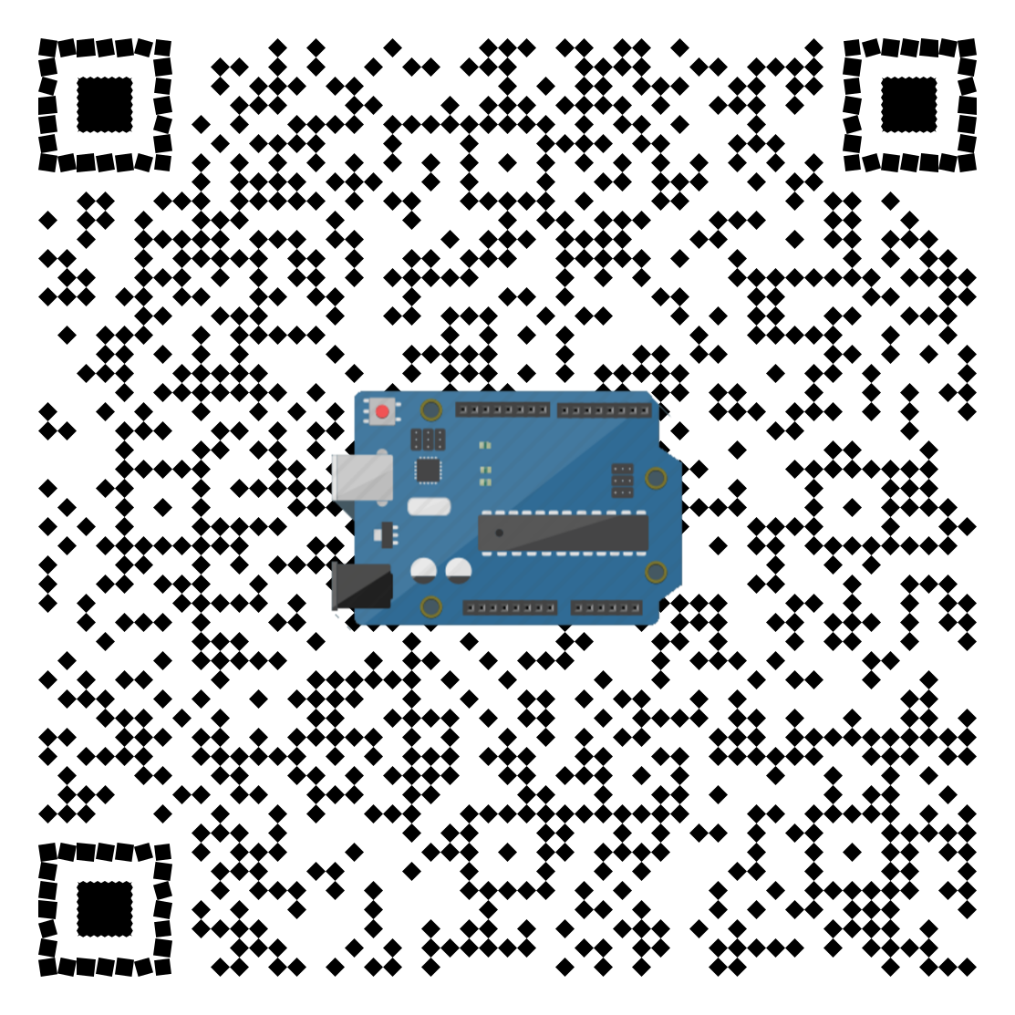
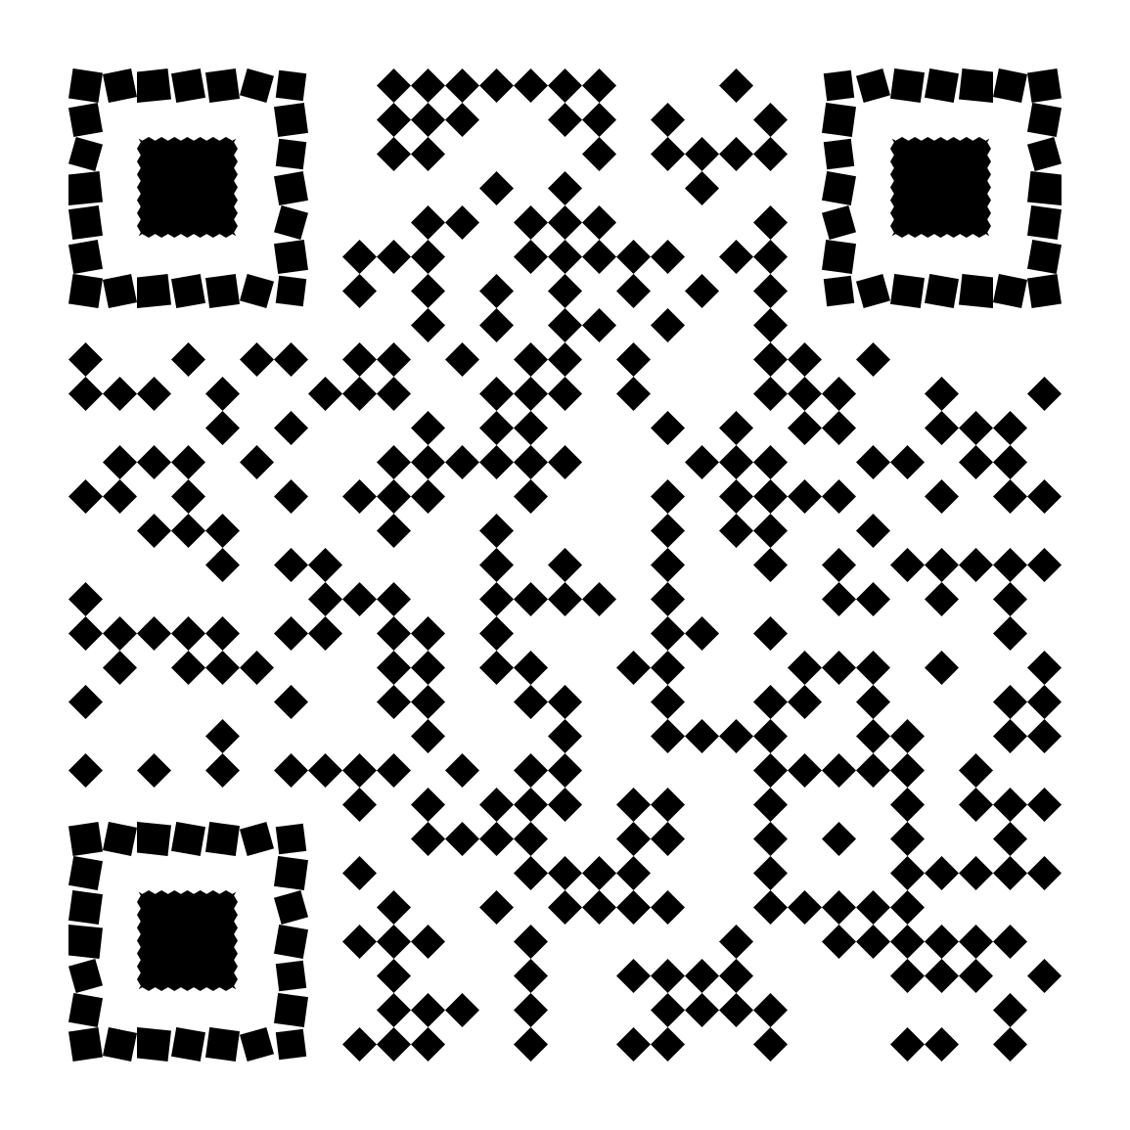
IoT DevKit Documentation
Firmware link

Slide 51
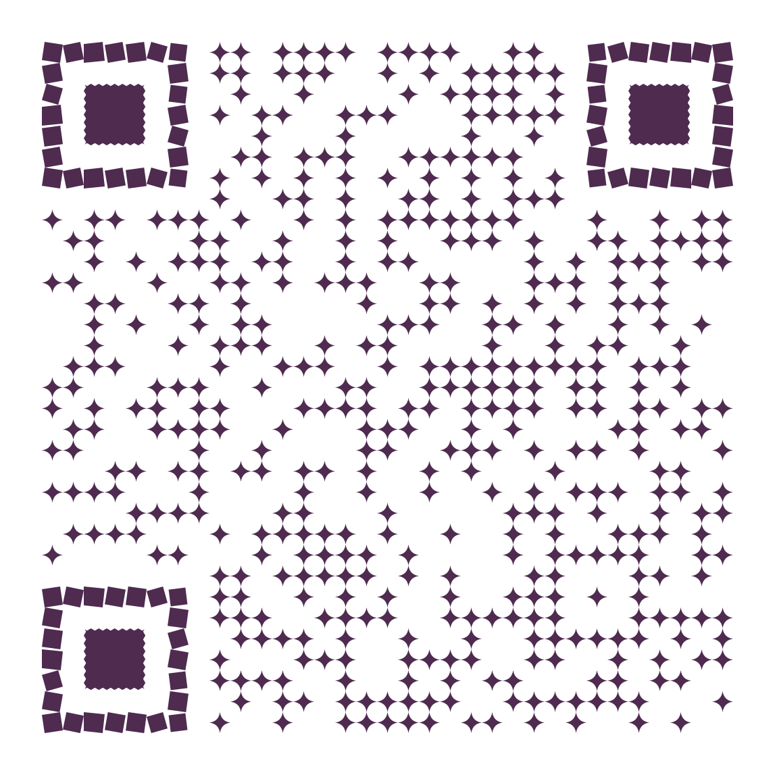
Demo
Set WIFI connection => Hold B, press Reset, release B
See sensors reading => Press B
Upload getting started program
Configure getting started
=> Hold B, press Reset, release B
set connection string from recent demo
Observe the magic
=> VS Code
=> configure IoT to Azure Blob storage connection

Slide 52
Demo: Create IoT Hub
Create IoT Hub
Create Device
Remember connection string

Slide 53
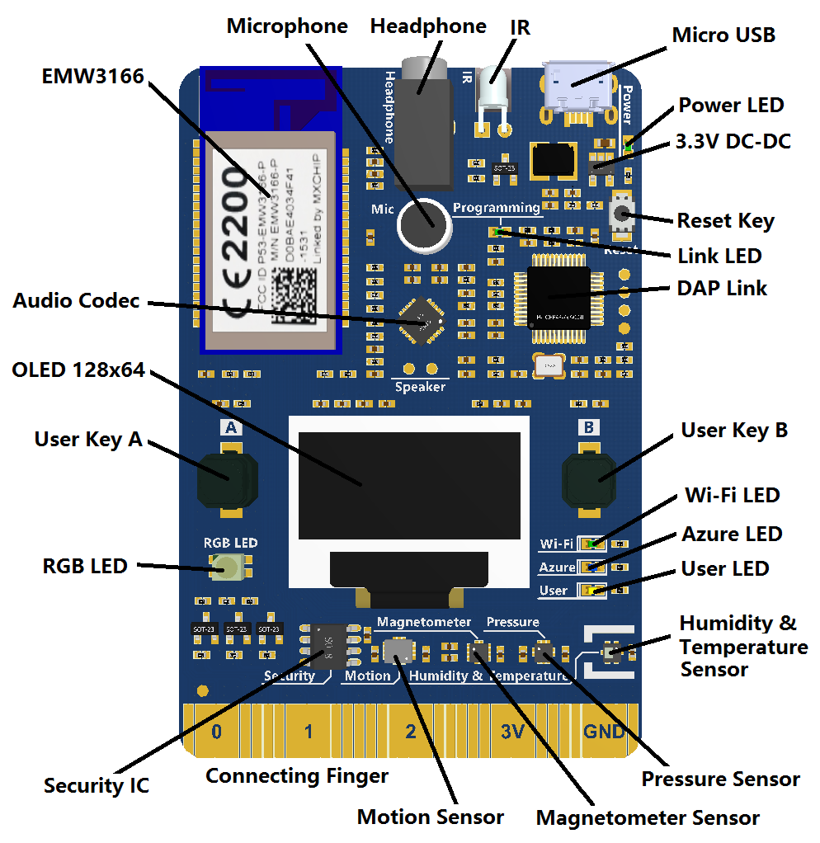
MXChip az3166 IoT DevKit
Main control unit of AZ3166 is EMW3166-a low power
EMW3166 Wifi module with 256K SRAM,1M+2M Byte SPI Flash
DAP Link emulator
MicroUSB
3.3V DC-DC,maximum current 1.5A
Codec,with ,microphone and earphone socket
OLED,128×64
2 user button
1 RGB light
3 working status indicator
Security encryption chip
Infrared emitter
Motion sensor
Magnetometer sensor
Atmospheric pressure sensor
Temperature and humidity sensor
Connecting finger extension interface

Slide 54

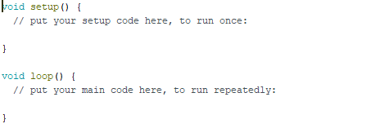
IoT DevKit

Slide 55
Demo Remote Monitoring

Slide 56
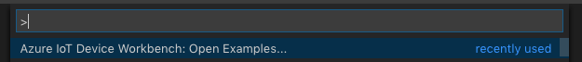
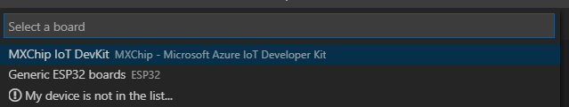
Deploy Remote Monitoring using VS Code

Slide 57
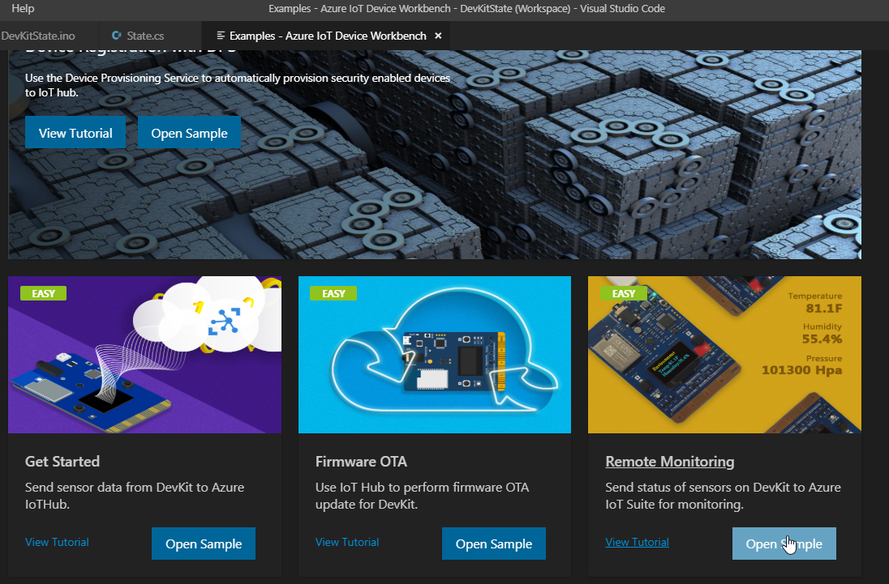

Slide 58
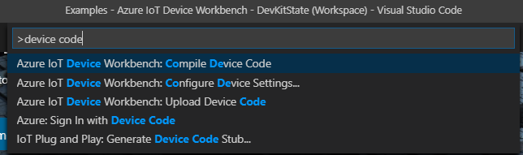

Slide 59
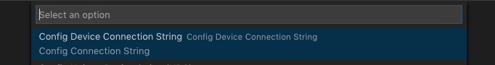
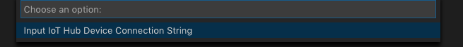
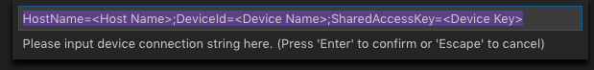
Configure connection string

Slide 60
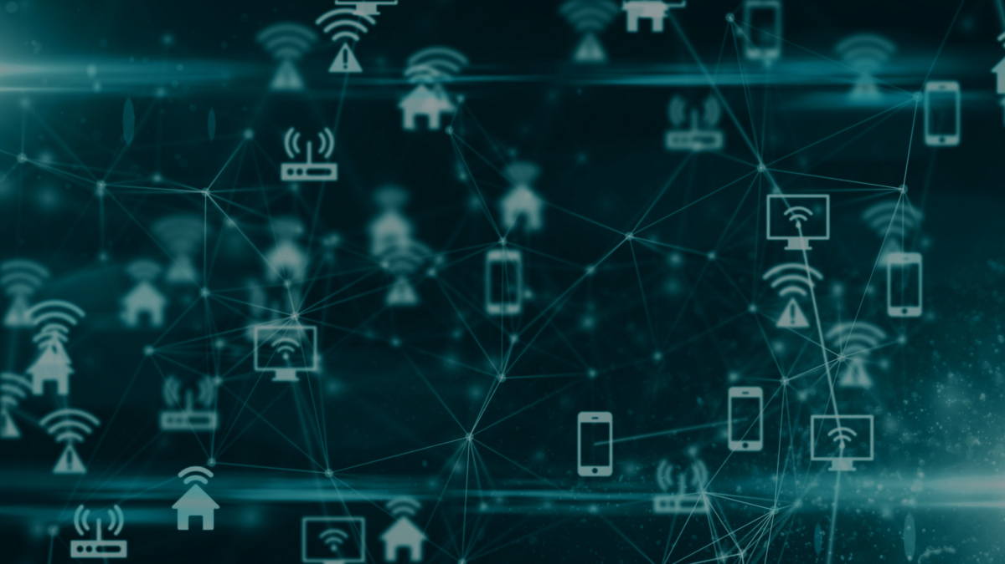
Collecting information from lots of devices is cool - but it is just telematics.
Merging perspectives between devices, systems, and humans to build a better understanding of the world around us. But tying together insight with action —there lies the promise of IoT.

